Slide 1
Case Study - 1
Web Based Solution

Slide 2
See the Question In Image

Slide 3
Q1) You are deploying the web-based solution in the West Europe region.You need to copy the repository of existing works that the plagiarism detection service uses. You must achieve this goal by using the least amount of time.What should you do?
Copy the files from the source file share to a local hard disk. Ship the hard disk to the West Europe data center by using the Azure Import/Export service.
Create an Azure virtual network to connect to the West Europe region. Then use Robocopy to copy the files from the current region to the West Europe region.
Provide access to the blobs by using the Microsoft Azure Content Delivery Network (CDN). Modify the plagiarism detection service so that the files from the repository are loaded from the CDN.
Use the Asynchronous Blob Copy API to copy the blobs from the source storage account to a storage account in the West Europe region.

Slide 4
Q1) You are deploying the web-based solution in the West Europe region.You need to copy the repository of existing works that the plagiarism detection service uses. You must achieve this goal by using the least amount of time.What should you do?
Copy the files from the source file share to a local hard disk. Ship the hard disk to the West Europe data center by using the Azure Import/Export service.
Create an Azure virtual network to connect to the West Europe region. Then use Robocopy to copy the files from the current region to the West Europe region.
Provide access to the blobs by using the Microsoft Azure Content Delivery Network (CDN). Modify the plagiarism detection service so that the files from the repository are loaded from the CDN.
Use the Asynchronous Blob Copy API to copy the blobs from the source storage account to a storage account in the West Europe region.

Slide 5
Explanation
Link: https://msdn.microsoft.com/en-us/library/dn806394.aspx
Why Not A ? Copy would take a lot of time from Source File Share to Hard disk and then use Azure Export service to West Europe Data Center.
Why Not B ? Create an Azure virtual network to connect to the West Europe region. Then use Robocopy to copy the file from the current region to the West Europe region.
Reason : Creating a Virtual Network and connecting (Creating a VPN would take a lot of time)
Why Not C ? This solution provides an access but does not perform the actual copy that is mentioned in the Question.

Slide 6
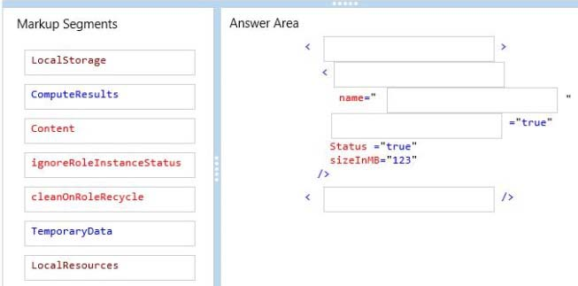
Q2) You need to configure storage for the solution.

Slide 7
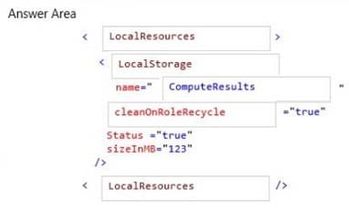

Slide 8
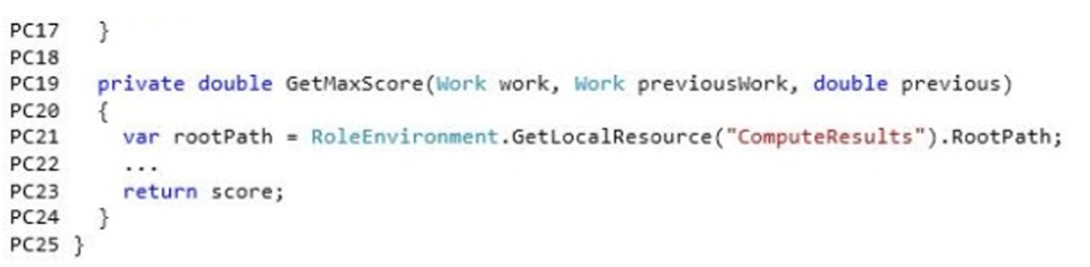
Explanation
For getting the Max Score He specifies the rootpath as GetLocalResource(“ComputeResult”). RootPath. Also it is mentioned that
“Computation results are cached in local storage resources to reduce computation time.” - Because it is cached data, clean on role recycle is true
The local storage is like memory (inside the instance) but will get clean when new instance of worker role is formed.

Slide 9
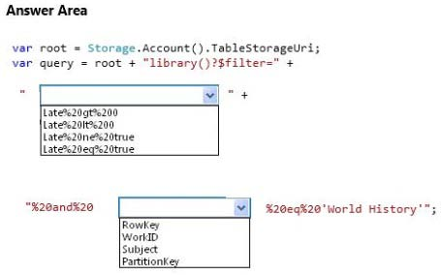
Q3) You need to find all existing works about World History that are overdue and are stored in the repository.

Slide 10
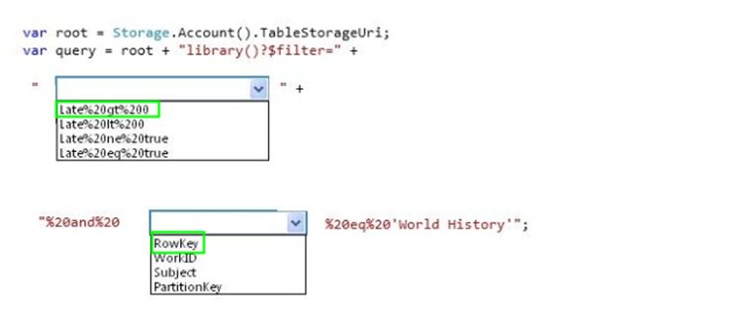

Slide 11
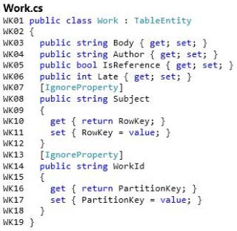
Exclude-a-property-from-being-persisted-in-azure-table-storage. Subject is used as the ROWKEY
Exclude-a-property-from-being-persisted-in-azure-table-storage. WorkId is used as the Partition Key.

Slide 12
Explanation.
Late > 0 means overdue
We have [Ignore Property] for the subject so it is not persisted as a column in the table. Subject is defined as the RowKey so we should select rowkey.
Here WorkId is specified as the partition key also the work id is not stored in the table.
Better Understanding of ROWKEY AND PartitionKey
More About the partitioning keys and Rows keys and designing a scalable partitioning stratergy: https://docs.microsoft.com/en-us/rest/api/storageservices/fileservices/Designing-a-Scalable-Partitioning-Strategy-for-Azure-Table-Storage?redirectedfrom=MSDN#dft

Slide 13
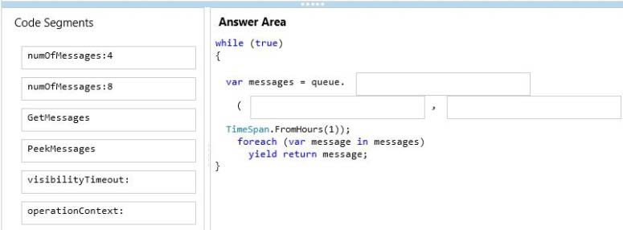
Q4) You need to insert code at line WR16 to implement the GetWork method.

Slide 14
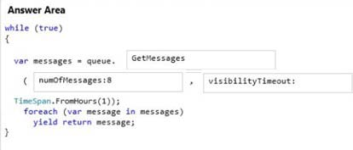

Slide 15
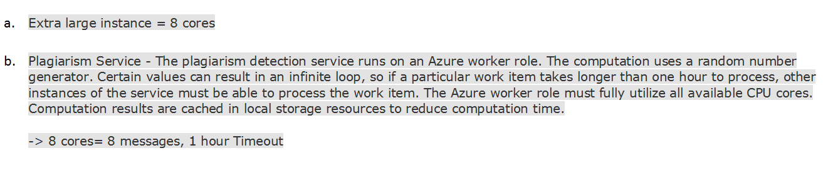
Explanation
The plagiarism detection service runs on an Azure worker role. The computation uses a random number generator. Certain values can result in an infinite loop, so if a particular work item takes longer than one hour to process, other instances of the service must be able to process the work item. The Azure worker role must fully utilize all available CPU cores.
The plagiarism detection service runs on Extra Large instances.

Slide 16
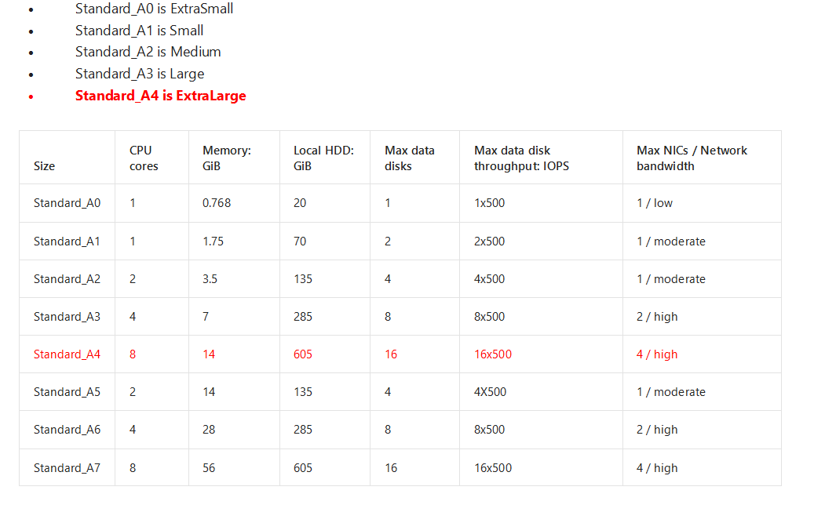

Slide 17
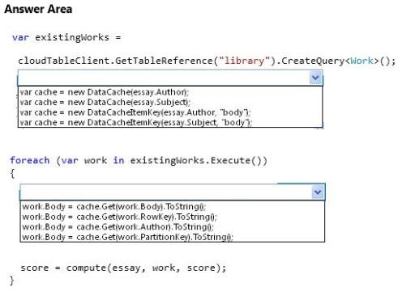
Q5) The Compute method in the PlagiarismCalculation class takes a significant amount of time to load existing works from blob storage. To improve performance, the service must load existing works from the cache. You need to modify the Compute method in the class PlagiarismCalculation.

Slide 18
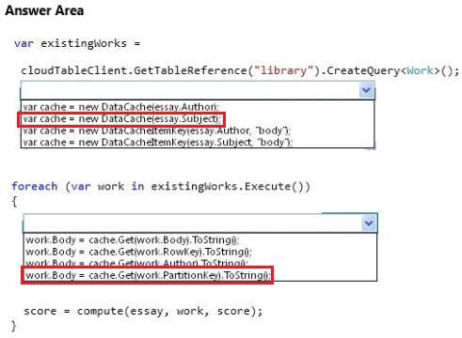

Slide 19
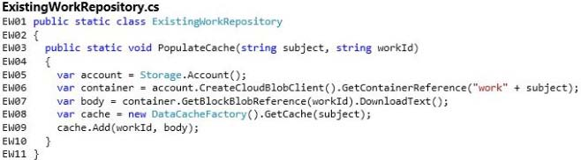
Explanation
Cache is created using Subject.
Body is added with the WorkId as a key.
In existingRepository a cache entry is added with cache.Add(wordId,body) . Partitionkey property is the WorkId.

Slide 20
Q6) You update the portion of the website that contains biographical information about students.You need to provide data for testing the updates to the website. Which approach should you use?
Use SQL Server data synchronization.
Use the Active Geo-Replication feature of Azure SQL Database.
Use SQL Replication.
Use the Geo-Replication feature of Azure Storage.

Slide 21
You update the portion of the website that contains biographical information about students.You need to provide data for testing the updates to the website. Which approach should you use?
Use SQL Server data synchronization.
Use the Active Geo-Replication feature of Azure SQL Database.
Use SQL Replication.
Use the Geo-Replication feature of Azure Storage.

Slide 22
Explanation.
“Biographical information about students and teachers is stored in a Microsoft Azure SQL database”
Option D is not correct because the biographical info is stored on Azure SQL Database not storage.
Option B , Geo Replication would create a read only copy of the SQL Database. But it is mentioned clearly in the Question that we need to update the data.
Option C, would replicate the complete SQL database.
Option A is correct because we need to update a portion of website that works with Biographical information, only data related to that change need to be sent. So use Azure SQL Data Synch (Synchronization).
https://docs.microsoft.com/en-us/azure/sql-database/sql-database-get-started-sql-data-sync

Slide 23
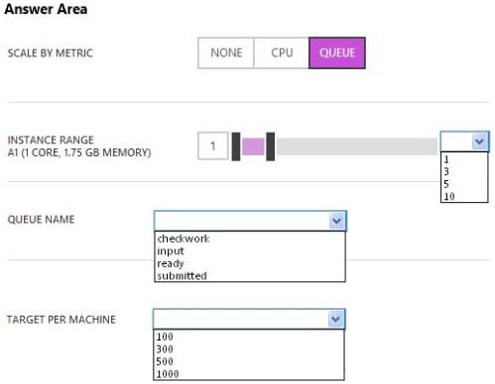
Q7) You need to configure scaling for the plagiarism detection service.
What should you do? To answer, select the appropriate values in the dialog box in the answer area.

Slide 24
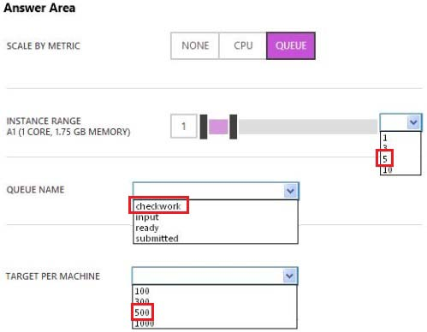
You need to configure scaling for the plagiarism detection service.
What should you do? To answer, select the appropriate values in the dialog box in the answer area.

Slide 25
Explanation.
“During non-operating hours, the plagiarism detection service should not use more than 40 CPU cores. During operating hours, the plagiarism detection service should automatically scale when 500 work items are waiting to be processed. To facilitate maintenance of the system, no plagiarism detection work should occur during non-operating hours.”
Not more than 40 Cores . Each Instance 8 cores. So maximum number of instances would be 5. Scaling should work based on the length of the Queue.
Hint for name of the Queue is given at the code in WR.

Slide 26
Q8) You need to provide the work action on the teacher controller object.

Slide 27
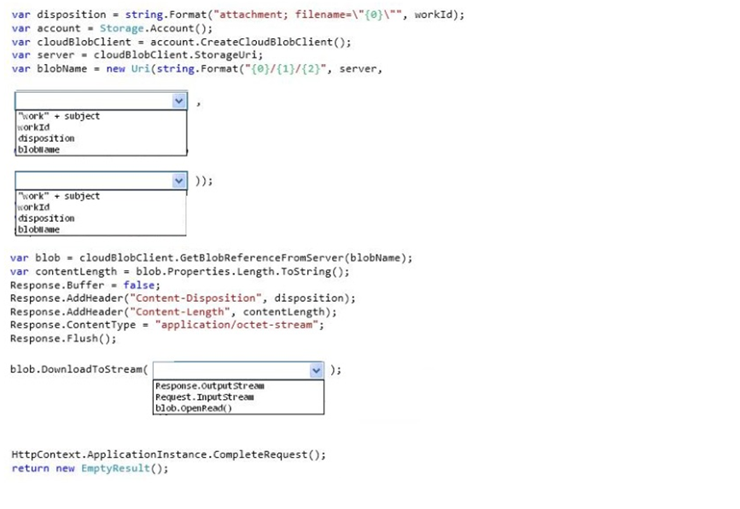

Slide 28
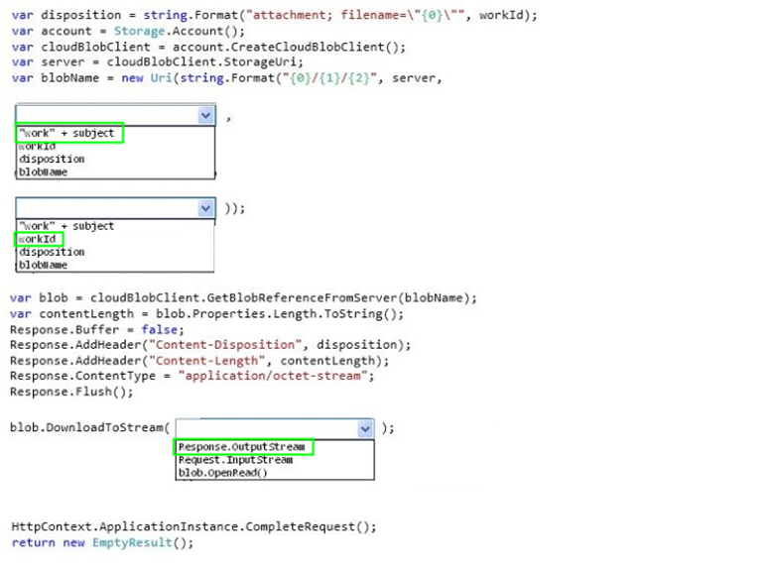

Slide 29
Explanation.
Name of the container is “work”+subject.
Name of the Blob is workID.
Need to push the output stream so that the student can download the form,

